Slide 1

Code Refactoring Techniques
Modern Topics in Information Technology
4th Year – Semester 1
Lecture 5
By Udara Samaratunge

Slide 2
Usage of Properties
.properties is a file extension for files mainly used in Java related technologies
This is used to store configurable parameters of an application.
They can also be used for storing strings for Internationalization and localization.
Known as Property Resource Bundles.
Properties are configuration values managed as key/value pairs.
In each pair, the key and value are both String values.

Slide 3
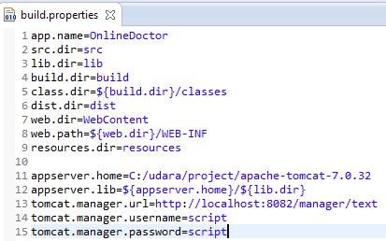
Usage of Properties
Properties extends java.util.Hashtable. Some of the methods inherited from Hash Table support the following actions:
Testing to see if a particular key or value is in the Properties object
Getting the current number of key/value pairs
Removing a key and its value
Adding a key/value pair to the Properties list
Enumerating over the values or the keys
Retrieving a value by its key
Finding out if the Properties object is empty.

Slide 4
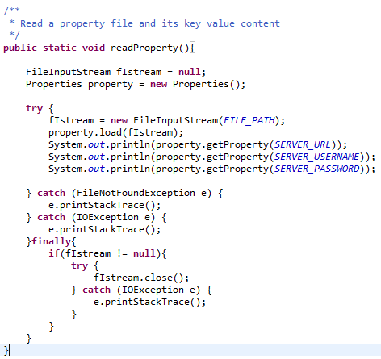
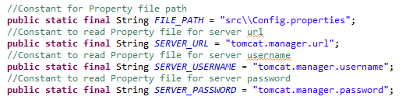

Read property file
Out put

Slide 5
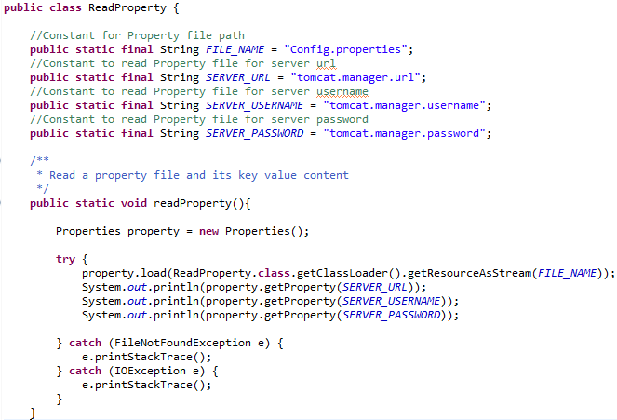
Best Practices
File Name
Use InputStream and access through class path

Slide 6
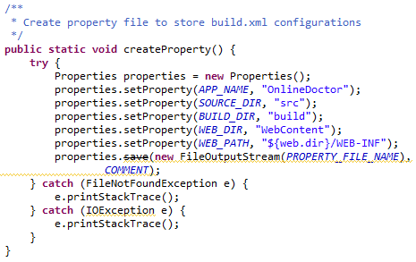
Generate property file
Don’t use Deprecated methods. Instead search the most suitable method
Instead use store() method

Slide 7
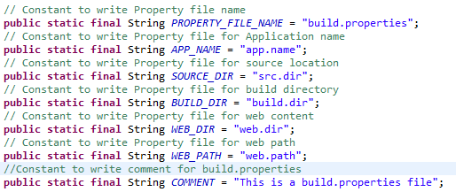
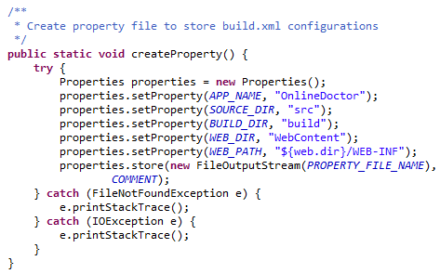
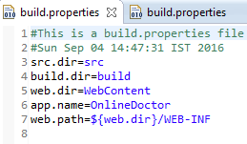
Best Practice

Slide 8
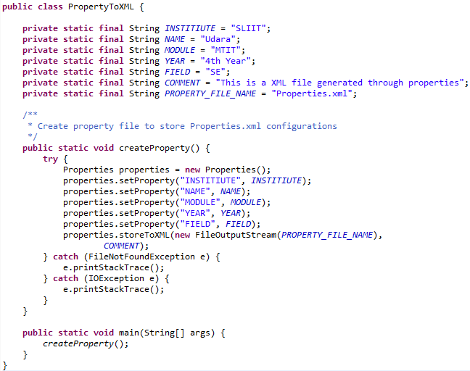
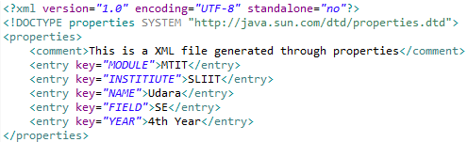
Property to XML File
Properties.xml

Slide 9
Pass parameters for Property file
Use java.text.MessageFormat
MessageFormat provides a means to produce concatenated messages in a language-neutral way. Use this to construct messages displayed for end users.
MessageFormat takes a set of objects, formats them, then inserts the formatted strings into the pattern at the appropriate places.
String java.text.MessageFormat.format(String pattern, Object... arguments)
You can pass any number of arguments for the property file using MessageFormat and you have to pass the String Pattern with specifying indexes in curly braces to display passed parameters. Eg:- {0},{1}, {2}…etc

Slide 10

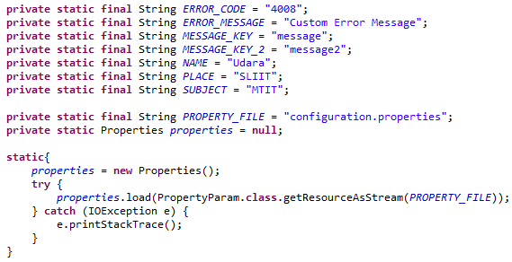
Create Configuration.properties
Load Configuration.properties

Slide 11
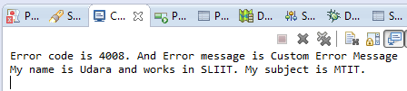
Response

Slide 12
XML Manipulations

Slide 13
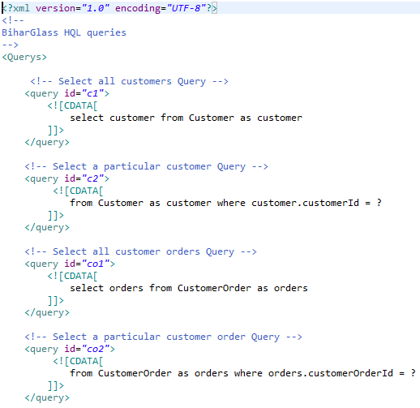
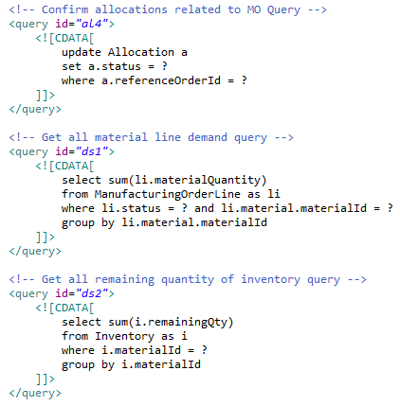
Embed Queries into XML

Slide 14
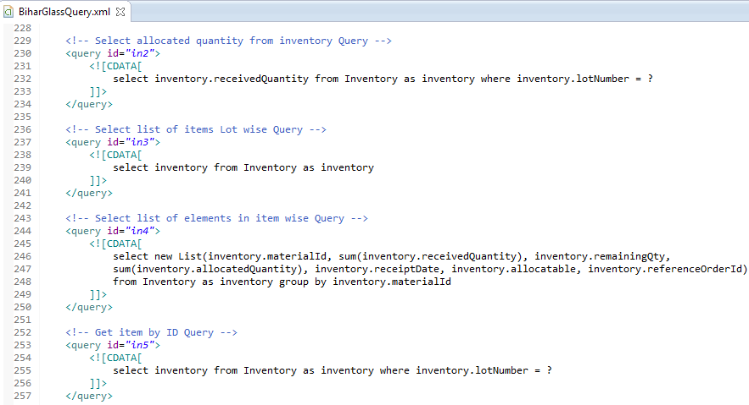
HQL Queries in a XML

Slide 15
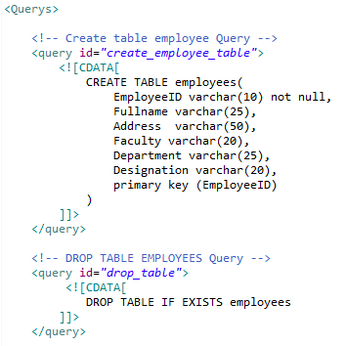
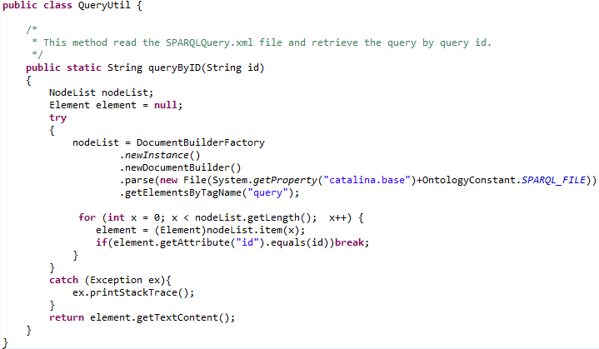
Read Elements in XML query

Slide 16
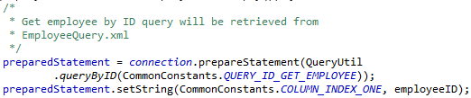
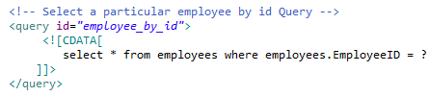
Employee ID will be assed as a parameter for xml element

Slide 17
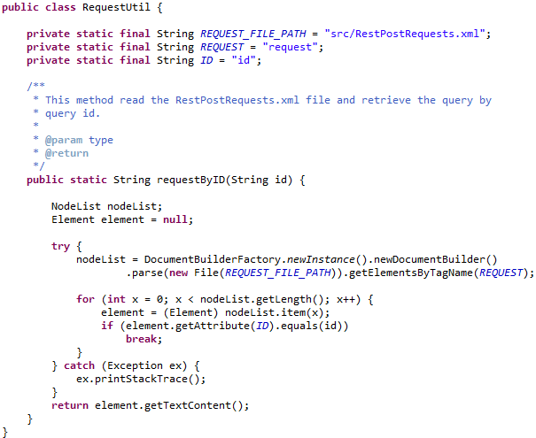
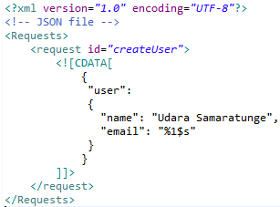
Inject Parameter to XML file

Slide 18
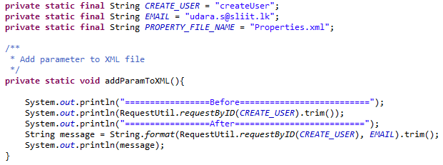
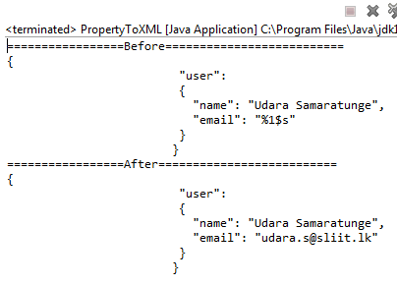
Response

Slide 19
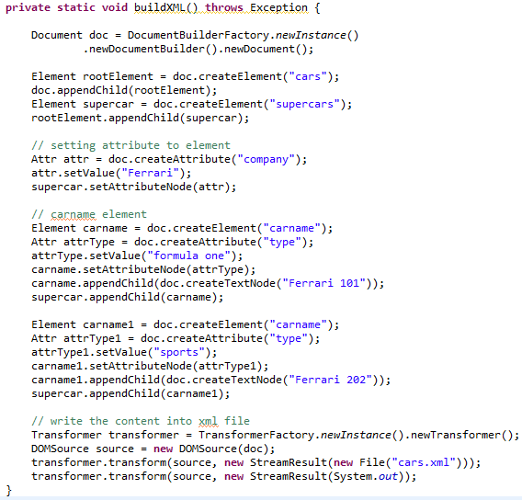
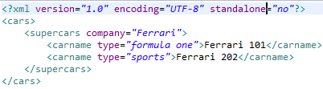
Generate XML file
Response

Slide 20
Separation of Logic and refactor considering cohesion and coupling

Slide 21
What is the Problem ???
Logics were not separated
Cohesiveness of the method?

Slide 22
Identify Logics to be separated
Create XML document builder
Create Element
Add name to element
Create Attributes
Add attributes to Element
Transform response to XML

Slide 23
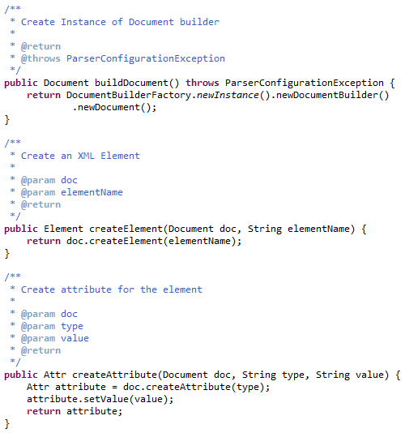
Separation of Logics
Create XML instance
Create Elements
Create Attributes

Slide 24
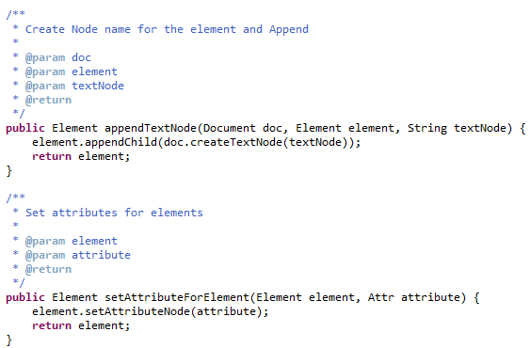
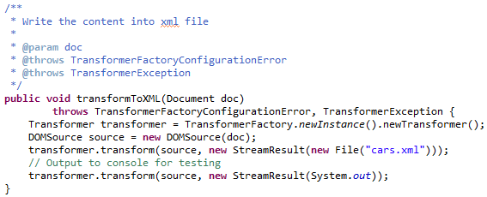
4. Add name to element
5. Add attributes to Element
6. Transform response to XML

Slide 25
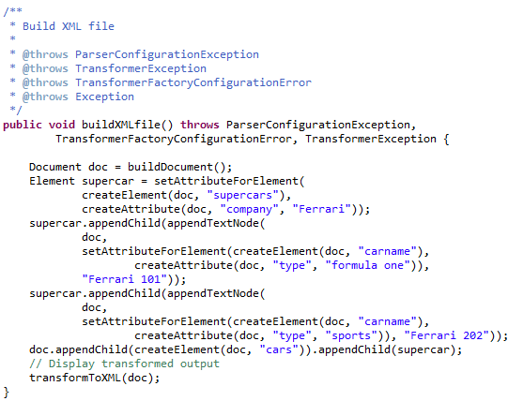
Build XML file invoking implemented methods and append child elements accordingly
Response

Slide 26
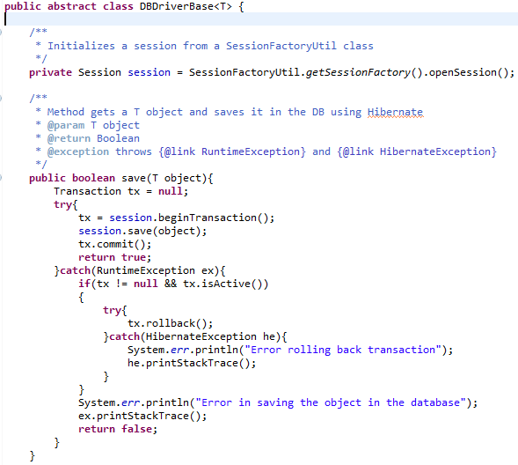

Usage of Generics
Implementation of Generic templates is good practice in implementation

Slide 27
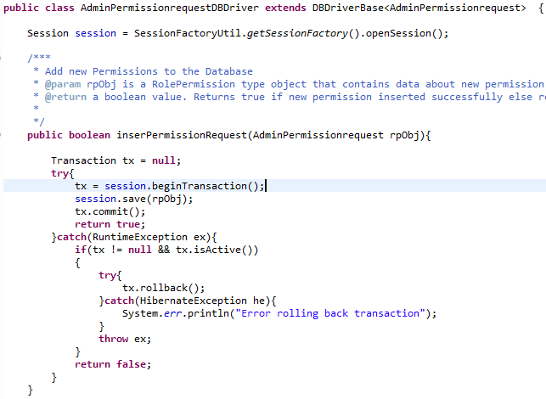
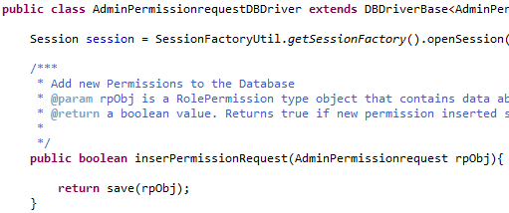
Bad Practice
Generic template NOT USED properly

Slide 28
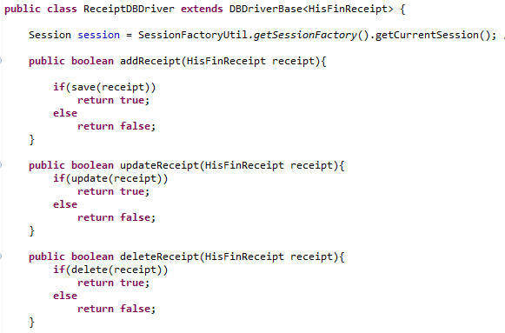
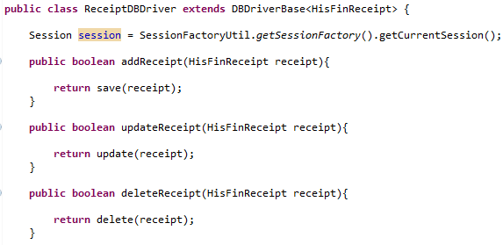
Required Code Refactoring
Understood the generic design concept.
But code was not refactored.

Slide 29
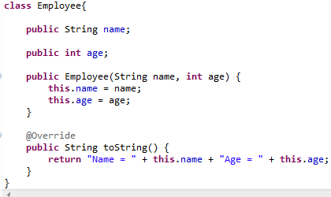
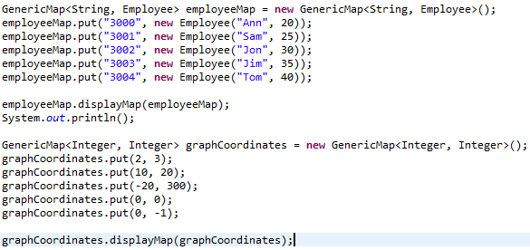
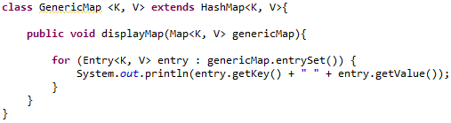
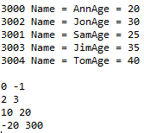
Generic Implementation
Outputs

Slide 30
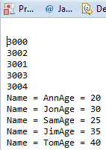
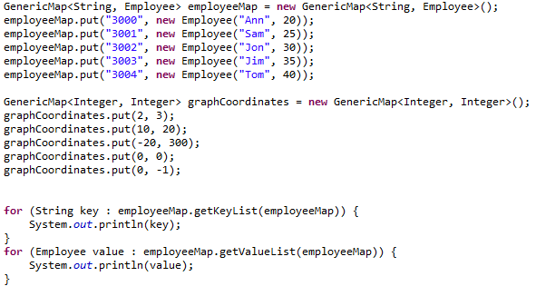
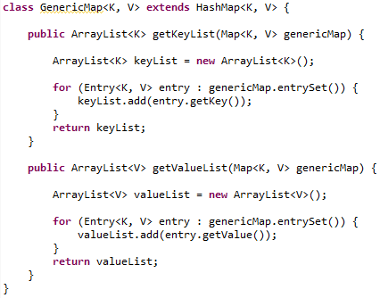
Generic Implementation

Slide 31
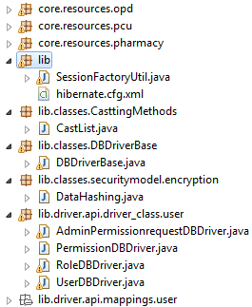
Tips for development
DataHashing secure class should be a utility. (Move to Util Package)
Don’t use “lib” as package name here.
You should have proper packaging and naming conventions.
All naming conventions should be documented and everybody should follow it.
Classes, methods, Comments and other implementation should follow common template.
Template should be documented & shared in the repository.
Learn how to use code repository.
Use merge tools to merge large source files.

Slide 32
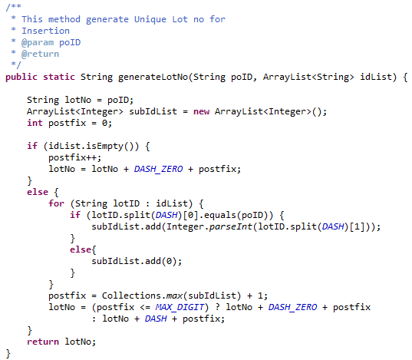
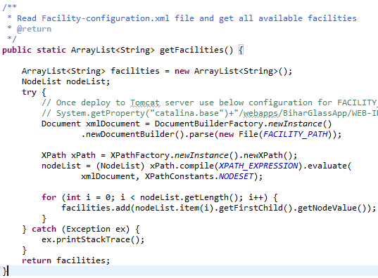
Implement Utilities

Slide 33
The End

